Slide 1
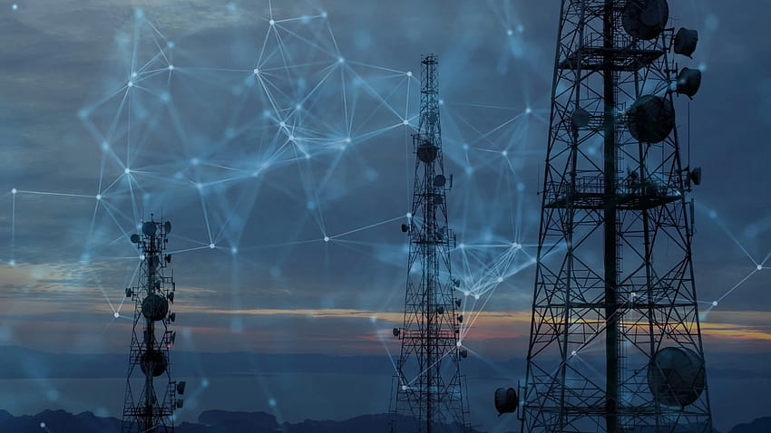

SRI LANKA TELECOM PLC KURUNEGALA
Name -: I.M.S.S. Jayarathna
Registration no -: 192198
Period of Training -: 27th of May to 26th of November

Slide 2
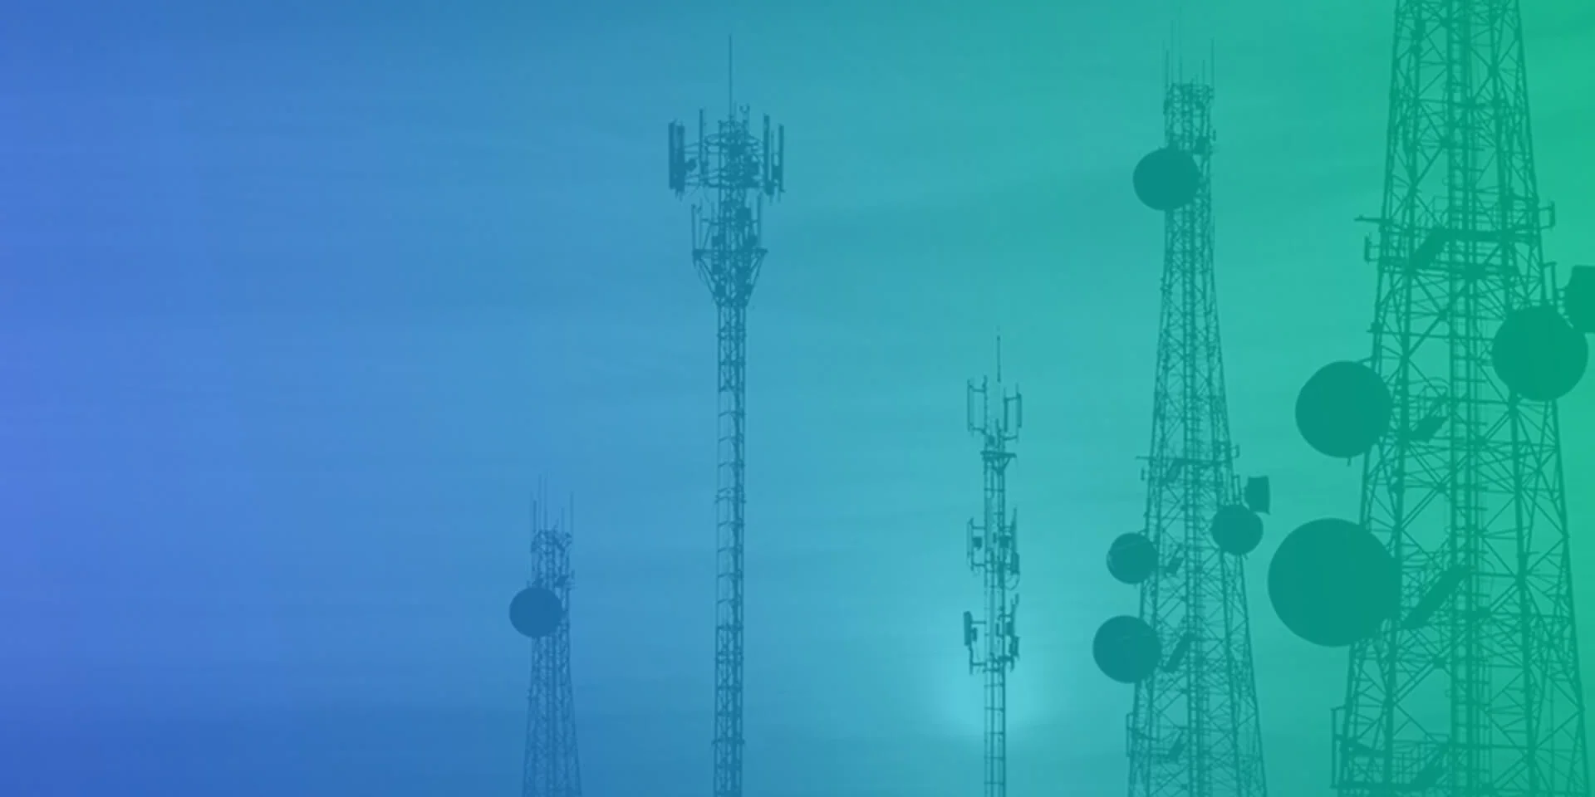
CONTENTS
Introduction
Vision and Mission
Organization Structure
Sections
Overall Experiences
Suggestions and Improvements

Slide 3
Introduction
Sri Lanka Telecom (SLT) is the leading telecommunications service provider in Sri Lanka, it provides telecommunication services to public.
Main services are voice, internet, Peo – TV, Data
SLT Network |  | Transmission Media | Signal Carried
Wired | ADSL | Copper | Electrical Signal
 | FTTH | Optical Fiber | Optical Signal
Wireless | 4G LTE | Radio Waves | Radio Signal

Slide 4
Vision and Mission
Vision
All Sri Lankans seamlessly connected with world-class information, communication and entertainment services.
Mission
Your trusted and proven partner for innovative and exciting communication experiences delivered with passion, quality and commitment.

Slide 5
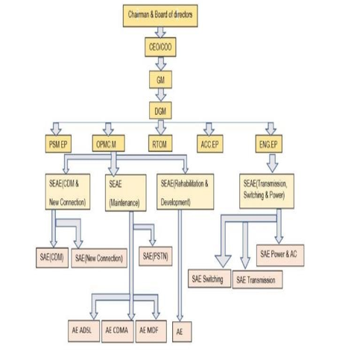
Organization Structure

Slide 6
Organization Structure
Mainly Sri Lanka Telecom – Kurunegala can be divided into 3 parts.
OPMC Section -: New connection, Maintenance, Planning,
(OPMC Manager’s Office) Rehabilitation, ADSL
Network Section-: Switching, Transmission
(Network engineer’s Office)
RT Office -: Telemarketing, Call Center, Admin work
(R.T.O.M.S Office)

Slide 7
Sections
Maintenance
Switching
Transmission
Rehabilitation
ADSL
Planning
New Connection

Slide 8
Maintenance Section
Restoring the Failures of voice, Internet, PEO tv and DATA services clearing line faults.
Restoring faulty customer equipment in his premises by repairing or replacing faulty ones.
Reporting special heavy damages to rehabilitation section for early repairs.

Slide 9
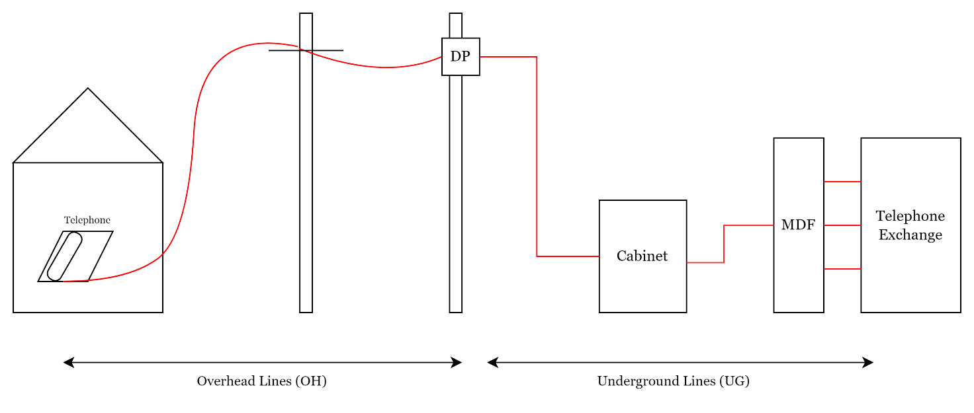
Maintenance Section
SLT OSP Network

Slide 10
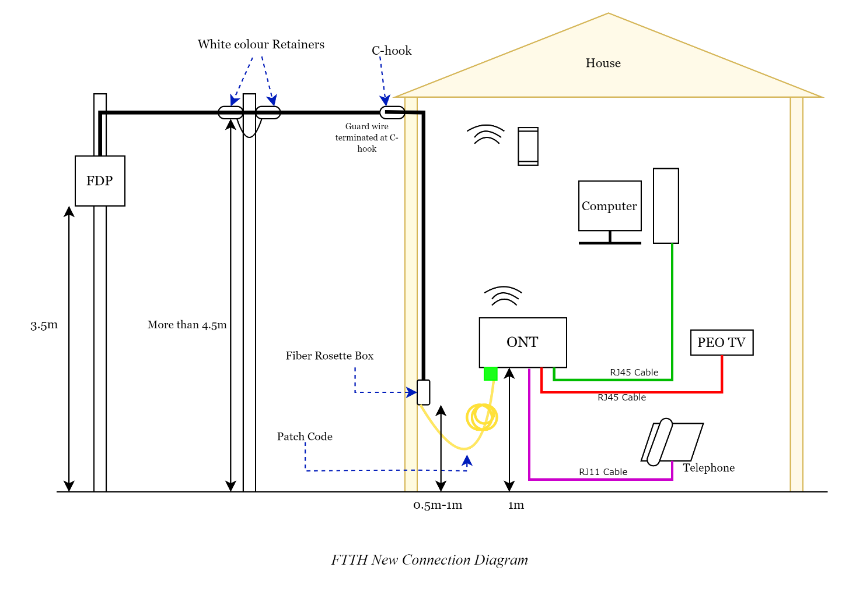

Maintenance Section
SLT FTTH Network

Slide 11
Maintenance Section
Special Damages
Accident effects.
eg -: vehicle damages, damages done by public.
Natural effects.
eg-: Falling of trees, damages done by rain, wind & lightnings.
Wire thefts.
eg-: Done by people.
Animal effects
eg-: Biting of monkeys & rats etc.

Slide 12
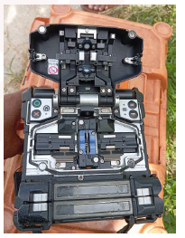
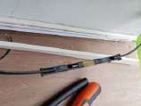
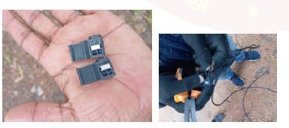
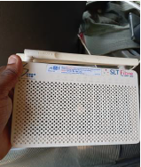
Maintenance Section
Methods of restoring
Splicing – Fiber Lines
Connecting – Copper wires.
Replacing - Poles ,heavily damaged cables & Wires. Damaged telephones, routers, power packs, rossets, splitter, ONT etc.

Slide 13
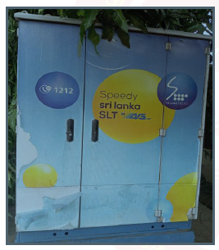
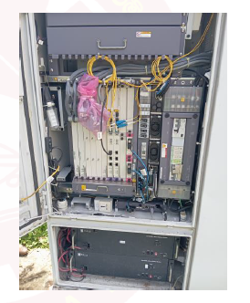
Switching Section
Operation and Maintenance of Transport Networks
Development and Tool Management.
Maintenance MSANs.

Slide 14
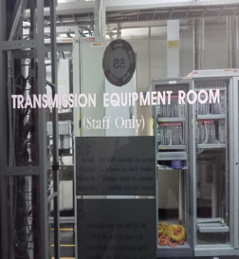
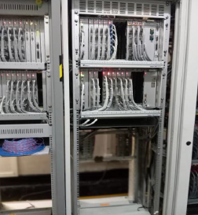
Transmission Section
Preventive and Corrective Maintenance
Infrastructure Management
Splicing main wires

Slide 15
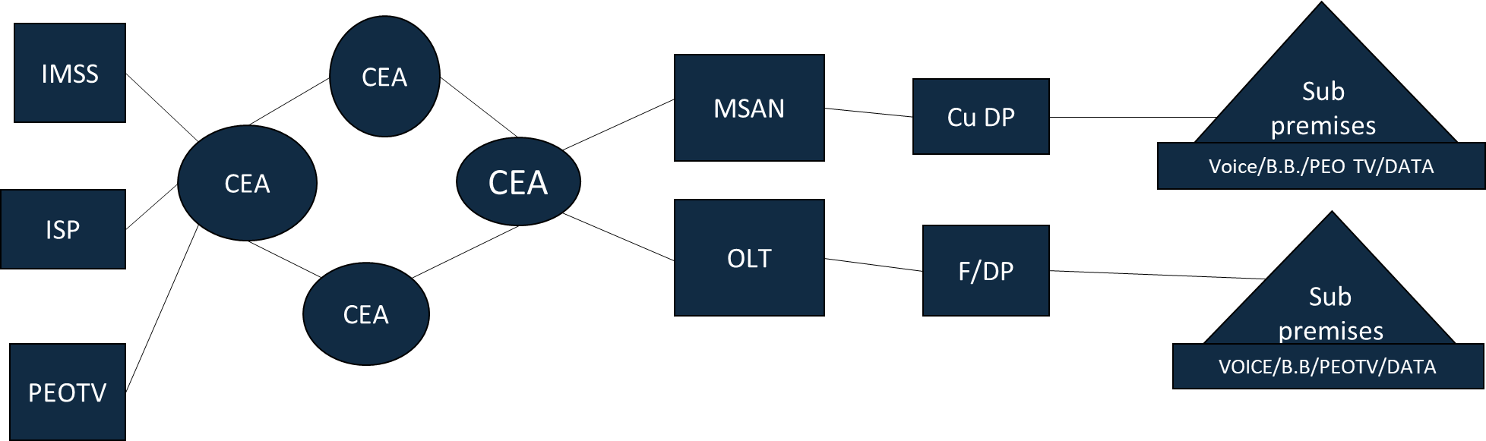
Transmission Section

Slide 16
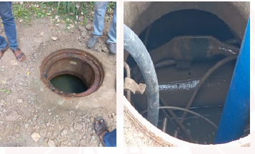
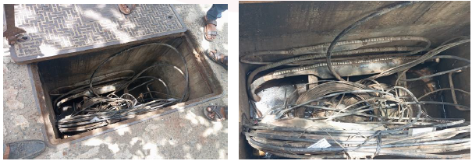
Rehabilitation Section
Correcting of major breakdowns.
Preventive maintenance work.
Work to be done in manholes.
Route clearance.
Manhole & hand hole repairing.
Cutting slanted trees to telecom lines.
Replacement of broken poles, faulty cables.

Slide 17
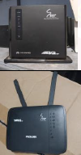
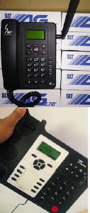
ADSL Section
ADSL section delivers comprehensive customer solutions related to signal issues, ensuring stable and efficient internet connectivity.
The team's duties include configuring key devices such as Fiber Optical Network Terminals (ONT) and LTE wireless routers to optimize performance.
ADSL Section handles the replacement of faulty customer equipment with new devices.

Slide 18
Planning Section
Provided New DPPs to proper places clustering the available customers, present waiters and future demand.
10 waiters can be providing the service with a copper DP.
8 waiters can be providing the service with a fiber DP.
Services are Voice, Internet and Peo- TV and DATA.

Slide 19
New Connection Section
Fulfill the requirements of New customers(waiters).
Makes the path drawing line to customer premises from DP with copper and fiber drop wires.
Then install the subscriber instruments (telephone, ONT, Routers, Rosset box etc.) in subscriber premises.

Slide 20
Overall Experience
Team work
Time Management
How to identify the problem
How to solve the problems
Communication

Slide 21
Suggestions and Improvements
More workshops on technologies
Welfare Activities

Slide 22
THANK YOU !

